Slide 1
ACI Automation platform design
^{2nd} Iteration – draft
High Level design – MVP 1
Marcel Janssen
System Architect – Infra Automation
Eindhoven
V1.2

Slide 2
Document history
Version | Description | Updated by | Date | Approver/Owner | Date approved
1.0 | Initial version MVP1 | Marcel Janssen | jan-2022
1.1 | Revised ACI Automation design based on session 17-feb-2022 | Marcel Janssen | 18-feb-2022
1.2 | Revised ACI Automation design based on session 30-mar-2022 and comments based on version 1.1 | Marcel Janssen | 04-apr-2022

Slide 3
To Do list
Items to add a later stage to document
# | Description | Added by | Date added to list | Status | By Who?
001 | Items to be added Incorporated feedback on version 1.1 (Geoffrey) Global policies vs RDC policies AAC Pipeline (happy flow) (pipeline) Notifications Monitoring Fail safes and testing Adjust non-standard change flow to allow reusing of Building Blocks ACI Deployment (unhappy flow, draft) Jenkins Executor Components (awaiting info from Cisco) Service Account approach (awaiting info from Joeri) | Marcel Janssen | 17-feb-2022 | Open
002 | Reporting and dashboarding (awaiting requirements from NTT Ops) Roles and Responsibilities Role based access control (RBAC) and policies Backup and Recovery | Marcel Janssen | 08-apr-2022 | Open

Slide 4
Topics
Context & Scope
Infrastructure overview
Git Repositories & branching
Orchestration (Rundeck)
Deployment (Cisco AAC Framework)
AAC Framework details
Site Reliability Engineering

Slide 5
Context and scope

Slide 6
Context and scope
ACI Automation
ServiceNow / Rundeck / Ansible Tower
Domain agnostic
This document
orchestration
Ignio
OCI
vRealize
OEM
Cisco ACI AAC
Domain specific
TCS Managed
Storage
eIaaS
Databases
Connectivity
Infra services

Slide 7
Context and scope
Starting points and assumptions
This design is based on the following starting points
ACI Automation only supports serialized changes on a single ACI/RDC configuration repository at any given time;
ACI Automation supports parallel deployments across RDC repo’s. e.g. One EID ACI deployment and one TPE ACI deployment can run in parallel
ACI Automation does not support “batched/combined” deployments where the changes of multiple requests/changes are clubbed together to make 1 single ACI deployment. One change request = One AAC deployment run per RDC;
ACI Automation does not support high volume deployments (multiple changes per minute)
Assumption: spinning up/down multiple devices (VM’s/Containers) at the same time does not incur changes on existing ACI constructs (like adding individual hosts to EPG, applications contracts)
No customizations to Cisco AAC framework that may cause a void in support from Cisco
If new requirements pop-up that impact any of the listed assumptions, the ACI automation solution described in this document will not work and significant redesign is required

Slide 8
Context and scope
Guiding principles
Lean pipeline (CI/CD best practice)
Limit the amount of testing and checks in the pipeline to a minimum
Ensure the shortest possible time a pipeline is running
Deployment pipeline and APIC are considered closed source to ensure ACI stability and deployment quality, direct human interaction with pipeline and APIC for AAC managed objects should therefore be avoided
Handling of deployment failures (unhappy flow)
“fail forward” is the preferred method of recovering from issues caused by deployment failures where P3/P4 incident has been logged and accepted
Re-Apply “Last known good Configuration (n-1) is the preferred method for recovering from issues caused by deployment failures where P1/P2 incident has been logged and accepted

Slide 9
Infrastructure overview

Slide 10

ACI automation connectivity setup
New
ACI / Connectivity Automation
EID_P_TENANT7
EID_P_TENANT4
EID/HTC_TENANT2_SSZ
Existing
ServiceNow
Tibco / Mulesoft
Rundeck
Connectivity ExecNodes
TCP/443
Infra Automation Stepping Stones
Splunk
RDC_???
Executors
TCP/xxx
RDC APIC
TCP/22
Non-Prod APIC EID
TCP/xxx
TCP/7999 SSH
TCP/7999 SSH
TCP/443
TCP/443
agent
TCP/443
TCP/636 LDAP
Bitbucket
Jenkins Master
Artifactory
Monitoring
CyberArk
GDS
EID_P_TENANT13
EID_P_TENANT7

Slide 11
Cisco AAC Components
Overview
Jenkins Executor
Component3
Component2
RHEL8
Awaiting AAC requirements (pip) from Cisco, Action: Akini/Hamza

Slide 12
Git repositories

Slide 13
Design decisions and assumptions
Repositories / inventory files
Automation related coding, building blocks and automation related configurations is stored and managed in the code repositories of CoreIT Infra Automation ART (ADAT)
Coding stored in ADAT follow the release cycles and coding standards of CoreIT Infra Automation ART
ACI related configurations are stored in separate repositories are owned and managed by CoreIT Infra ART and Infra Ops (NETA)
The RDC and Global Policies inventory files only contain the specific App-Centric objects created and managed by AAC Framework (whitelisting)
Net-Centric or App-Centric objects created “manually” on the APIC are not affected by the AAC Deployment framework
AAC created/managed object are annotated by the AAC deployment framework in the APIC. The annotated attribute is not visible in the GUI (attribute name, tbd)
AAC created/managed objects receive a pre-fix in the description attribute of an object: --AAC– to indicate visually in the APIC GUI that this object can only be managed from the AAC deployment framework
Each RDC repository contains a single inventory file (yaml) containing the configuration of the complete Tenant (RDC)
Global Policy Repository changes are in all cases performed using the “non-standard change/request flow” process described in slide 22 of this deck

Slide 14
ACI related Bitbucket Projects & Repo’s
Repo | Contains | Ownership | Used by
ACI Orchestration | Ansible playbooks to orchestrate and generate yaml constructs to submit to ACI Config Repo’s | Infra ART | Infra Automation ART
ACI Templates | Fixed deployment templates used by ACI orchestration playbooks to generate yaml constructs | Infra ART | Infra Automation ART
ACI AAC Pipeline | All coding for the Cisco AAC deployment pipeline to operate. Note! Binaries required for the AAC framework to operate are located in Artifactory not in this repo | Infra ART | Infra Automation ART
ADAT
Bitbucket Project
NETA
Bitbucket Project
Repo | Contains | Ownership | Used by
ACI RDC Configs (5x) EID / HTC / LVG / NRW / TPE | All yaml configuration and policy files required to configure and manage the APIC for each RDC, Based on whitelisting concept. If it’s not in the inventory file (yaml) it will not be deployed to APIC. This is to avoid affecting existing net-centric or app-centric objects created outside the AAC deployment | Infra ART | Infra ART / Connectivity Ops
ACI Global Policies | SSoT for the global policies and configurations that apply globally. Changes to this repository is only allowed using the non-standard change/request flow process | Infra ART | Infra ART / Connectivity Ops

Slide 15
Branching strategy
NETA
Bitbucket Project
ACI RDC config repo’s (EID/HTC/NRW/LVG/TPE / Global)
Persistent branches
Development (non-prod)
Master (prod)
Release (diff branche)
Non-persistent branches
Hotfix
Features
Standard changes or Operations tasks (form based) are committed directly to master without separate approval (!)
Hotfixes may be used for Incident (Impact/Urgency) resolution
Non-standard changes or bugfixes are contained in features
Manual approvals are required for merges to development and master branch
PR approval to development can be done on peer review approval
Deployment pipeline (Cisco AAC) is automatically triggered on Pull Requests (PR) merges on development and master
Release
✓
✓
✓
Standard change + OPS Rundeck forms
Master
✓
✓
✓
RDC APIC (production)
Incident
deploy to
Hotfix
(Non-persistent)
Development
✓
✓
✓
RDC APIC (non-prd)
Features
(Non-persistent)
Non-standard change
deploy to

Slide 16
Branching strategy
ADAT
Bitbucket Project
ACI Coding and Template Repo’s
Persistent branches
Development (non-prod)
Master (prod)
Non-persistent branches
Features, Hotfix, Release (acc)
Follow standard Infra Automation ART branching strategy and pipeline deployments
Follow standard Infra Automation ART versioning system
Major release x.0.0 (In case of product innovation / LCM)
Release 1.x.0
Hotfix 1.1.x
Follow standard Infra Automation ART deployment calendar; 1x (planned) deployment to production per sprint following the ASML IT change process
Master
✓
✓
Rundeck (prd)
P1/P2 incident
deploy to
Hotfix
(Non-persistent)
Release
(non persistent)
✓
Rundeck (acc)
deploy to
Development
✓
✓
Rundeck (dt)
Features
(Non-persistent)
deploy to
Feature request

Slide 17
Orchestration Rundeck

Slide 18









ACI basic automation flow
Operations
Job (meta) data
(aac versions)
PAM
Orchestration
forms
Deployment
APIC Simulator
(non-prod)
API Call
ExecNode
Pipeline triggered by Rundeck
Integration Layer
API Layer
forms
Updates
Cisco AAC Pipeline
RDC APIC (PROD
yaml
yaml
Repo – ACI RDC Norwalk
ACI Repo
Manual chances
forms
Repo – ACI RDC Las Vegas
Requestors
Repo – ACI RDC Taipe
Repo – ACI RDC EID
Repo – ACI RDC HTC
Repo – ACI Global policies
Operations
features
InfraART + Ops teams
Manual Changes: AAC Managed objects are annotated (outside gui) should not be changed manually on the APIC. Objects that are not AAC managed can be changed manually and have no effect on the AAC deployment pipeline
Forms: Rundeck GUI based forms are used for allowing manual trigger of rundeck AAC deployment jobs for standard ACI Operational tasks by Operations and the InfraART for non-standard changes to the ACI/RDC Repositories

Slide 19
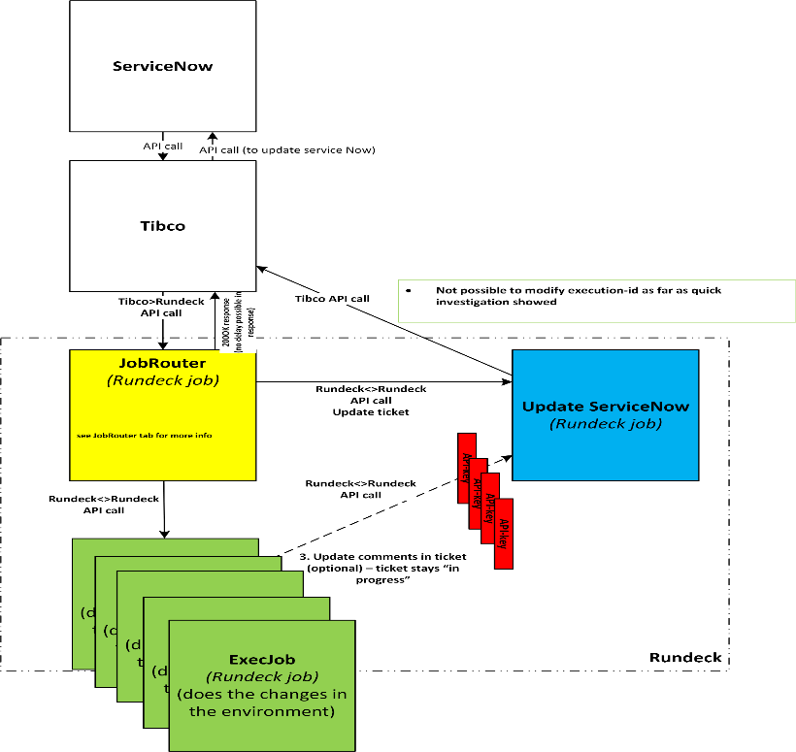
Detailed request flow integration
ServiceNow → Rundeck (Existing Integration)
Process Flow (detailed flow)
Customer fills in a REQ form in ServiceNow
On “Submit” and possible approval tasks a ctask is created by ServiceNow and assigned to Rundeck system queue
Assignment to Rundeck system queue triggers ServiceNow → Tibco interface
JobRouter receives request from tibco and sends back a 200-OK response
JobRouter Triggers the “Update-ServiceNow” rundeck job to update the task in ServiceNow with the following info:
Set task state to “In Progress”
Add the JobRouter ExecutionID in the ServiceNow : Correlation ID field with a prefix of DCA (example : "ID":"DCA<###>)
JobRouter identifies which request has been received and triggers the correct Rundeck Execution Job. It also sends the task number and correlation ID to the execution job for it further update any worknotes in SNOW.
Add the ExecutionJob – ExecutionID in the ServiceNow: Worknotes field.
ExecutionJob Sends one or more task (or output) updates to the “Work Notes” along with CTASK # and Correlation ID # field in ServiceNow via the “UpdateServiceNow” Rundeck job
Happy Flow Example: “Informing the requester of the hostname of the newly deployed VM)
Failure Flow Example: “Storage could not be provisioned due to lack of space”
On ExecutionJob Completion, Execution Job responds to JobRouter with a Job Status: Completed or Failure
JobRouter Triggers the “Update-ServiceNow” job to: (Happy Flow)
Update the comment field with update text (e.g.: Job Processing Completed successfully)
update the status of the task to: Closed Complete
JobRouter Triggers the “Update-ServiceNow” job to: (failure flow)
Update the comment field with update text (e.g.: Job Processing has not completed successfully, please refer to the comments for errors)
Update the status of the task to: Closed Failed
In all scenarios of updating to SNOW the execution job should pass the ID and correlation ID

Slide 20
Standard request flow
Create, Read, Update, Delete (CRUD)
Requesters
Operations
ServiceNow
Orchestration
1
Rundeck playbook
forms
forms
Cleanup Runbook env.
Update Request status “Completed”
Update Worknotes of request
Post pipeline log to splunk
Retrieve Jenkins Joblog based on Pipeline UID
1
JobRouter
5
CTask
5
5
1
2
Check input variables
Retrieve Credent. From PAM
Pull current config in “release”
Pull “CRUD” yaml template
Merge config with template
Commit yaml to repo
Trigger pipeline after successful “commit” on master
Poll Status
Update ServiceNow notes
3
3
yaml template
yaml template
4
deployment pipeline
5
Submit ServiceNow REQ (ctask) to Rundeck
Jobrouter triggers Runeck (playbook) Job (UUID)
Playbook provides regular updates to ctask (include progress and error messages)
A-synchronous trigger AAC pipeline using webhook
Rundeck “polls” Jenkins for status of Pipeline
If pipeline “completed, Rundeck finalizes the deployment
ACI RDC Config
RELEASE Branche
(NETA)
ACI Global Policies
Release Branche
(NETA)
ACI Template
MASTER Branche
(ADAT)
ACI RDC Config
MASTER Branche
(NETA)
deploy
Pipeline Job Log: We either “retrieve” the job log from Jenkins from the ACI deployment Rundeck job –or- we create a separate control plane feature where this ACI deployment rundeck job calls the control plane feature using an API (tbd, not MVP1)
Request completed notification: Requestor is notified of the delivery vial e-mai notification in ServiceNow
ACI Templates can be deployed to local file system of Connectivity ExecNodes as part of automated code deployment removing the need for a Git-Pull improving the speed of the playbook, to be discussed
Deployment pipeline
- On Successful deployment: Pipeline promotes/commits “master” branche to “release” branche
- On failed deployment: Manual rebase performs a rebase from “release” branche to “master” and “development” branche to remove the configuration (fail forward) Non-persistent branches are updated manually by the developer

Slide 21
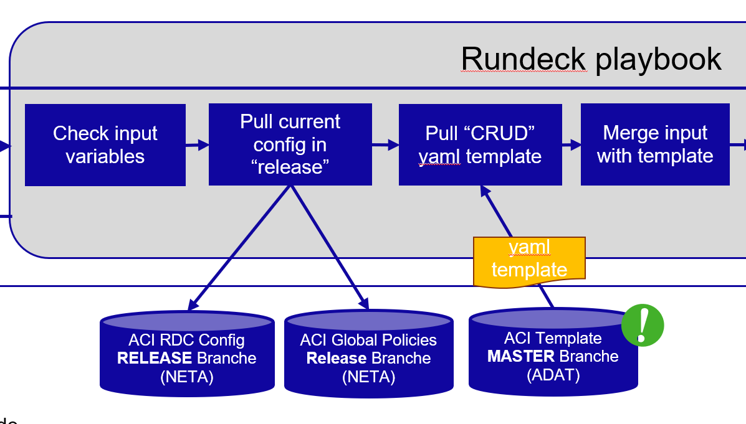
Global Policies vs RDC/APIC Specific policies
Merge configs from 2 repositories
Retrieve (pull) the RDC specific config from RDC Repo;
Retrieve (pull) the global policy config from Global Policies Repo;
Check for config conflicts between what is defined in RDC and Global Policies repo;
Merge the two configs into one single config for further processing.
Rundeck playbook
Check input variables
Pull Config from “release” (Steps)
Pull “CRUD” yaml template
Retrieve RDC config
Retrieve Global Policies config
Check for config overlap
Merge configs to single payload
4
1
2
3
ACI RDC Configuration repo
(NETA)
ACI Global Policies
(NETA)
Global Policy exist? | RDC Config exist? | Apply Config
Yes | No | Global policy**
No | Yes | RDC config
Yes | Yes | RDC config
Global Policies apply to all ACI/RDC environments. These configurations are stored in a separate repostory and are the SSoT reference point for configurations alongside. Preferably the global policy applies to all ACI/RDC environments and is therefore the preferred setup where no global policies are defined in the ACI/RDC Repo (**)
In cases where deviation to Global Policies are required the specific configs can be set at ACI/RDC repository level which will override the configurations in the global policy repository

Slide 22
Non-standard request / hotfix flow
Developing non-standard changes and/or hotfixes using feature branches
Commit feature branche and create a Pull Request
Approvers are notified by e-mail
Approvers review and approve the PR request
On approval Developer triggers the Rundeck Job for the deployment of the approved non-standard request or hotfix
Rundeck triggers the AAC deployment pipeline using a webhook to stay in control of the deployment
AAC Pipeline committed inventory files
And deploys the inventory files to ACI/APIC
InfraART + Ops teams
SCM (Bitbucket)
Orchestration (Rundeck)
Feature branche
manual
Playbook
manual
manual
forms
Trigger AAC deployment pipeline
3
5
manual
PR Approvers
AAC deployment pipeline
4
1
2
6
ACI RDC Configuration repo (NETA)
7
8
Feature development ”direct” access to the ACI/RDC repositories for the purpose of non-standard change and/or hotfix development comes with responsibilities which means only skilled development or Operations specialists should be allowed to have this access and need to adhere a pre-defined way of working in order to guarantee high quality deployments
Trigger AAC deployment pipeline is the main trigger using a webhook to start the AAC deployment pipeline. By triggering the deployment pipeline via a rundeck job instead of “branche triggered” has the purpose for the orchestration to remain in control of progress and status of the deployment as well as maintain metrics on job duration and success/failure rates
Global Policies Repository Changes: Modifications to the Global Policy Repository is in all occasions done via the non-standard request flow process creating a feature branche

Slide 23
Deployment
Cisco AAC Framework

Slide 24
Pipeline characteristics
High Level
The Cisco AAC Framework is a deployment framework which does not include orchestration capabilities
The AAC framework consists of:
Syntax and semantic validation checks
Ansible roles and collections that support Cisco ACI
Playbooks to deploy inventory files (yaml) configurations to ACI / APIC
Post deployment testing
ASML specific components added to the framework / pipeline:
Integration with Artifactory to check for new versions of Cisco AAC framework
Integration with Privileged Account Management (PAM) for retrieval of appropriate credentials

Slide 25
Deployment process
Happy flow
Rundeck
Jenkins Pipeline
Rundeck
Run Playbook
Start Pipeline
Pre-flight checks
Prepare Environment
Prepare deployment
Deployment
Post deployment checks
Complete pipeline
Complete Runbook
Rundeck job content (slide 20)
Trigger Jenkins Executor from Jenkins Master
(a-synch) Return - Status - Pipeline UID
Check AAC version in Artifactory
Pull inventory (yaml) file from NETA RDC
Syntax Linting
RDC inventory file
Snapshot APIC Config
(Ansible role)
Perform ACI config check
(Ansible role)
promote code to “Release” branche
Poll Pipeline for Completion
Identify RDC and environment from params
Set env. vars based on inventory file
- RDC - Prod/non-prod (based on branche)
Validate Inventory files
(Ansible role)
Deploy to APIC
(Ansible role)
Perform ACI health check (Ansible role)
Rundeck job content (slide 20)
Trigger AAC pipeline from Conn ExecNode via webhook on Jenkins Master
Cleanup pipeline params, vars
Retrieve credentials from CyberArk Vault
Pull “Release” branche config
Deploy steps:
Vars
Schema
Defaults
Diff config
Push config
Cleanup
Perform ACI Operations check (Ansible role)
Perform ACI health check (Ansible role)
Validate Inventory (diff)
(Ansible role)
Perform ACI configuration check (Ansible role)
Echo runtime params (for logging)
ACI Operations Check: To be verified if this is needed (action: Akini)
Snapshot task will not be performed, In the unhappy flow the “release” branche is manually rebased to master branche for reverting to “last known good configuration

Slide 26
Unhappy flow – recover from failed deployment
Starting points
Primary method for recovering from deployment failures is “Fail forward” used by P3 and P4 Incidents
Secondary method for recovering from deployment failures is “Re-Apply “Last known good Configuration”. Only used with P1/P2 service recovery (urgency). Case approval is required to perform this method
Both methods are performed manually
Trigger: ServiceNow Standard Request
Failures in the ACI Rundeck job or AAC pipeline results in a ServiceNow Request to be set to “Closed Failed”
ServiceNow holds the required business logic to create an incident based on the failed Request flow (technology already in place in ServiceNow
When incident is resolved, Requestor submits a new request, previous “failed” request is not re-opened
Trigger: Synchronous API Request
Any failure in the ACI Rundeck job or AAC pipeline results in an error response on the API to the requestor.
Requestor is responsible for logging an incident based in case the API request returns a failure code

Slide 27
Unhappy flow – recover from failed deployment
ServiceNow: Request / Incident process
Requesters
Operations
DevOps
5
Failure occurs in ACI deployment process, Worknotes field of the request is updated with root cause of failure (error messages)
Status of request is set to “Complete Failed”
Incident is automatically created by ServiceNow with request owner/support group, request details
Requestor is notified of the failed request and that an incident has been created for the failed request
Operations/DevOps liaises with Requester on incident process
Incident process
Create Incident and assign to support queue
4
Orchestration
3
JobRouter
CTask
2
2
Request Deployment
!!!FAILURE!!!
forms
Update ServiceNow notes
1
1
ACI Runbook
ServiceNow

Slide 28
Unhappy flow – recover from failed deployment
Method 1: “Fail forward”
Fail forward follows the defined branching and development strategy, which includes existing ASML (emergency) change and approval processes
Fail forward is accomplished by:
Creating a “hotfix” branch of “master” branche (Incident Urgency: high) or,
Creating a “feature” bracnche of “Development” branche and is treated as bugfix development (Urgency: medium)
The use of the “Hotfix” pattern requires Case-by-Case approval
Release
✓
✓
✓
Standard change + OPS Rundeck forms
Master
✓
✓
✓
RDC APIC (production)
incident
deploy to
1
Hotfix
(Non-persistent)
Development
✓
✓
✓
RDC APIC (non-prd)
2
Features
(Non-persistent)
Non-standard change
deploy to

Slide 29
Unhappy flow – recover from failed deployment
Method 2: Re-Apply(!) “Last known good Configuration”
Manually triggered Rundeck job
Re-Apply Last known good configuration
Release
✓
Standard change + OPS Rundeck forms
rebase
Deployment fails
Master
✓
deployment
RDC APIC (production)
✓
Successful merge
deployment
rebase
Development
deployment
✓
✓
RDC APIC (non-prd)
Features
(Non-persistent)
Non-standard change
rebase
✓
Rebase non-persistent branches: It’s the responsibility of the developer to rebase features or hotfixes with after a rebase is performed on the Master and Development branche

Slide 30
Unhappy flow – recover from failed deployment
Method 2: Re-Apply(!) “Last known good Configuration”
Operations
DevOps
Orchestration
1
2
Rundeck playbook
Incident
forms
Result
Manual
Check input variables
Retrieve Credent. From PAM
Rebase “Release” to “Master”
Rebase “Master” to “Development”
Trigger pipeline after successful “commit” on master
Poll Status
ServiceNow
deployment pipeline
Triage performed by DevOps Engineer based on generated incident
DevOps Engineer triggers the Rundeck playbook to Re-Apply the “Last known good Configuration”
Incident is automatically created by ServiceNow with request owner/support group, request details
Requestor is notified of the failed request and that an incident has been created for the failed request
Operations/DevOps liaises with Requester on incident process
ACI RDC Config
RELEASE Branche
(NETA)
ACI RDC Config
MASTER Branche
(NETA)
ACI RDC Config
DEVELOP Branche
(NETA)
deploy
Bitbucket
Block Requests: Do you block new requests from processing when a deployment failure has occurred for the respective RDC Config? TBD
Who approves a Re-Apply: Who approves the rollback of a failed deployment assuming the inventory files where committed to the RDC Repositories but the deployment failed

Slide 31
Notifications
ACI / AAC deployment notifications
Notification type | Pattern | Who is notified | How
Successful AAC deployment | ServiceNow request | Requestor | Request status change “Closed Complete” in SN triggers e-mail notification to user
Failed AAC deployment | ServiceNow request | Requestor Infra Ops Engineer | Request status change “Closed Failed” in SN triggers e-mail notification to user ServiceNow Creates an incident (automatically) based on failed request details
Successful AAC deployment Failed AAC deployment | Received API Request | Requestor (API) | Automated API response (synchronous) – 2 codes responses
Successful AAC deployment Failed AAC deployment | Rundeck GUI form used by Infra Ops | Infra Ops Engineer | In Rundeck GUI (Job Result)
Create PR on RDC or Global policy Repo’s | Non-standard changes directly to Repo’s | PR Approver role | E-mail notification to approver <Role> for PR approval from within bitbucket
Rundeck Job (freezing) | Job runs too long for unknown reason | Automation Ops Engineer | Custom scheduled health check on running jobs – Rundeck Project based Rundeck sends alert to Ignio**, Incident is created and assigned to Support Queue Send e-mail notification to Infra Product team (for ACI, from servicenow) ** Temporary solution until application monitoring (App-D) is in place for Rundeck

Slide 32
AAC Details

Slide 33
Cisco AAC roles and collections
Notes:
Send link

Slide 34
Site Reliability Engineering (SRE)

Slide 35
PAM Integration and Service Accounts
Characteristics
Agentless integration to PAM (CyberArk Vault)
Retrieval of credential sets using secured certificates
Password safes owned and controlled by Core-IT Infra ART and/or Infra Ops
Credentials are never stored on disk, in-memory only
Credentials are securely passed on to target device (ssh)
Separate (service accounts) credentials are used for production and non-production ACI environments
Separate (service accounts) are used per RDC/APIC Setup (1 account for each RDC)
Frequent automated password rotation is on service account credentials
(dd. 30-mar-2022) Service Accounts: the use of Service accounts, number of service accounts and password rotation is to be decided by the Core-IT Infra ART, Action owner Joeri van Thienen

Slide 36
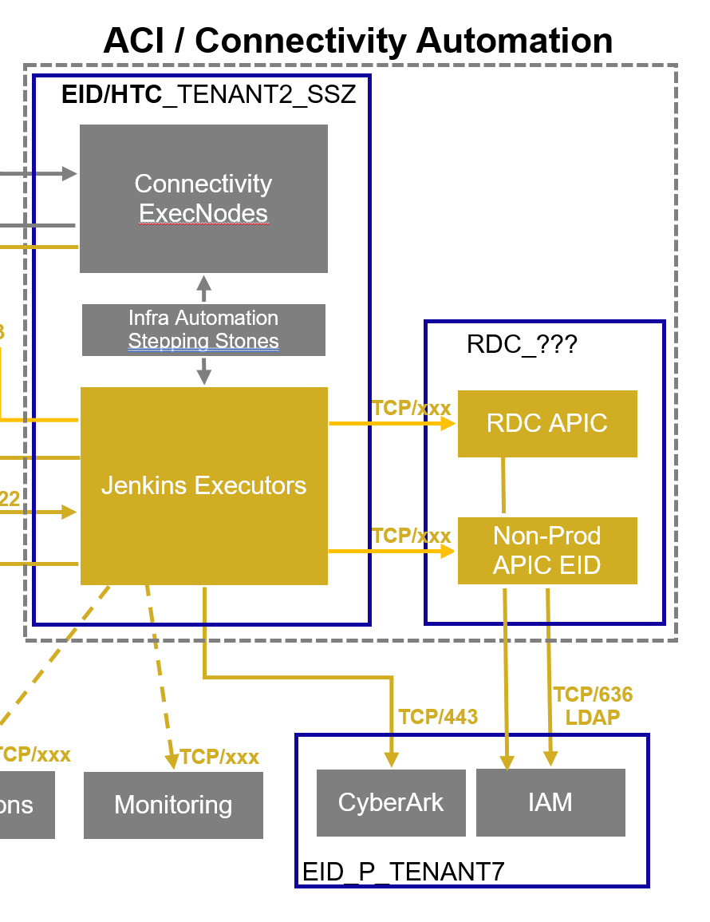


PAM Integration and Service Accounts
Technical overview
Config Deployment
Retrieve applicable credentials from password vault via secured connection based on RDC and/or prod/non-prod;
Log-in to target devices using credentials
Target devices authenticates credentials against GDS
Jenkins Pipeline
RDC APIC (PROD
GDS
(LDAP)
3
Jenkins Executor
Jenkins Master
2
APIC Simulator
(non-prod)
3
1
PAM
Credential
Safe
Password rotation
a
b
Central Password Manager
Credential vault
Privileged Access Management
Password rotation
Password rotation triggered by Central Password Manager
Credentials are updated in CyberArk Credential Vault
Service Accounts: Segregation of activities and traceability across the landscape is a security requirement, it is therefore advised to create multiple service accounts instead of creating a single service account for all ACI environments. (action: Joeri van Thienen)
Password Rotation: The use of frequent/automated password rotation is part of the security standards for handling privileged accounts.

Slide 37
Quality Assurance
Numerous testing and fail safes in place per layer
Access Control (RBAC)
Input control (regex)
Forms
Playbooks
(orchestration)
- Input syntax checks
- config checks “release branche”
Pre-defined configuration templates
Templates
- Access Control (RBAC) for SCM
- Policy protected branches
Source Control
- Peer review (4-eyes)
- Multi step approval flow (PR)
Pipeline
- Access Control (RBAC) for Jenkins
- Policy protected pipeline
- yaml linting
- Semantic validation
APIC
Health, Config, Operation checks
Revert on failed deployment
master
- Access Control
dev
feature

Slide 38




Agent overview automation stack
agent
Zabbix (P&T Managed)
Monitoring and Alerting
agent
Cisco App Dynamics (CoreIT Managed)
agent
Splunk (CoreIT Managed)
agent
agent
agent
Orchestration
agent
agent
agent
API Call
agent
Deployment
Integration Layer
ExecNode
Pipeline triggered by Rundeck
APIC Simulator
(non-prod)
Master
agent
Executor
ServiceNow
Updates
agent
Cisco AAC Framework
RDC APIC (PROD
agent
agent
agent
agent
Automation
Monitoring
PAM
Agents
Controller
Alert handling
metrics
ITOM
Cisco App Dynamics
Incident process

Slide 39
Agent overview automation stack
agent
Zabbix (P&T Managed)
Log shipping / Reporting / Dashboarding
agent
Cisco App Dynamics (CoreIT Managed)
agent
Splunk (CoreIT Managed)
agent
agent
agent
Orchestration
agent
agent
agent
API Call
agent
Deployment
Integration Layer
ExecNode
Pipeline triggered by Rundeck
APIC Simulator
(non-prod)
Master
agent
Executor
ServiceNow
Updates
agent
Cisco AAC Framework
RDC APIC (PROD
agent
agent
agent
agent
Automation
Logshipping & Reporting
PAM
Agents
Heavy forwarder
Automation Index
Reporting & Dashboarding
Logging
Splunk

Slide 40
Monitoring, Reporting and Dashboarding
Available services
Log shipping of all system and app logs to Splunk (1 year retention)
System / OS Level monitoring using Cisco AppD
Application Performance Monitoring (APM) using Cisco AppD → In build phase, Available in Q3 2022
Intermediate solution in place: Custom environment / application health checks
Reporting and Dashboarding using Splunk
Job information (success rate, average durations)
Information requirements: Awaiting information from NTT Ops on information requirements NTT Ops has fulfilling their day-2-day operations. Related to monitoring, AAC Deployment job information, Reporting, Dashboarding

Slide 41
AAC Framework updates
Lifecycle
Jenkins Pipeline
AAC Framework update check
On Job start; ExecNode checks the availability of a new AAC version
If so, Pull :latest AAC version (collections + roles) from Artifactory repo
:latest version is installed on Jenkins runner before continuing the deployment process
Rundeck ExecNode
Cisco AAC Framework
Jenkins Master
Jenkins Executor
APIC
1
3
2
Artifactory
Updating the AAC Framework
Check for new AAC version
Upload new version to Artifactory
b
www
a
Operations
Most common trigger for new AAC framework version is an update to Cisco ACI Release. Frequent checks are required to ensure Cisco ACI / AAC Framework compatibility
There is no “post-project” support arranged for Cisco AAC framework. The project engagement with Cisco consists of 1-time delivery of the framework after which it is assumed that ASML provides updates and all support

Slide 42
Automated Testing
Automated testing | . | . | . | .
Create, Read, Update, Delete
Integration testing
Regression testing
More details, Next iteration of design

Slide 43
Backup & Recovery
More details, Next iteration of design

Slide 44
Roles and Responsibilities
Activity | . | <role> | <roles> | <role> | <role>
<activity > or <process> |  | R | A | C | I
More details, Next iteration of design

Slide 45
Role based Access Control
Activities | <role> | <role> | <role> | <role>
Write access to RDC Configs in NETA bitbucket project (non-standard request)
Access in bitbucket for approving PR’s
Rundeck GUI access running Operational ACI deployment activities (forms)
…
More details, Next iteration of design

